Slide 1
VE450 Edge Online Training
Weekly Report wk#10
2018.11.14

Slide 2
Current Work
Presentation Layer: UI ( flask+ python)
Business Logic Layer: Batch Training Algorithm (SOM, IPCA)
Data Access Layer: Raspberry Pi

Slide 3
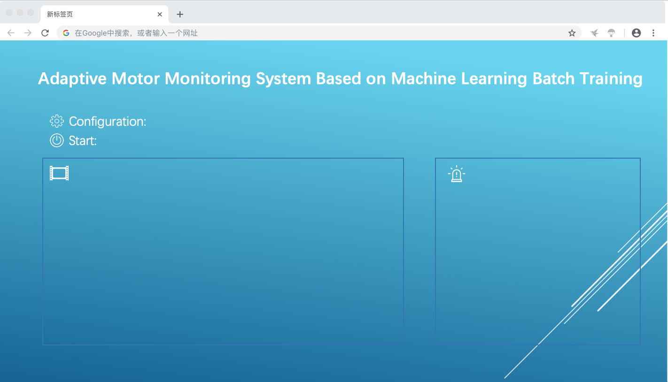
Web UI
Basic interaction
Web UI Design

Slide 4
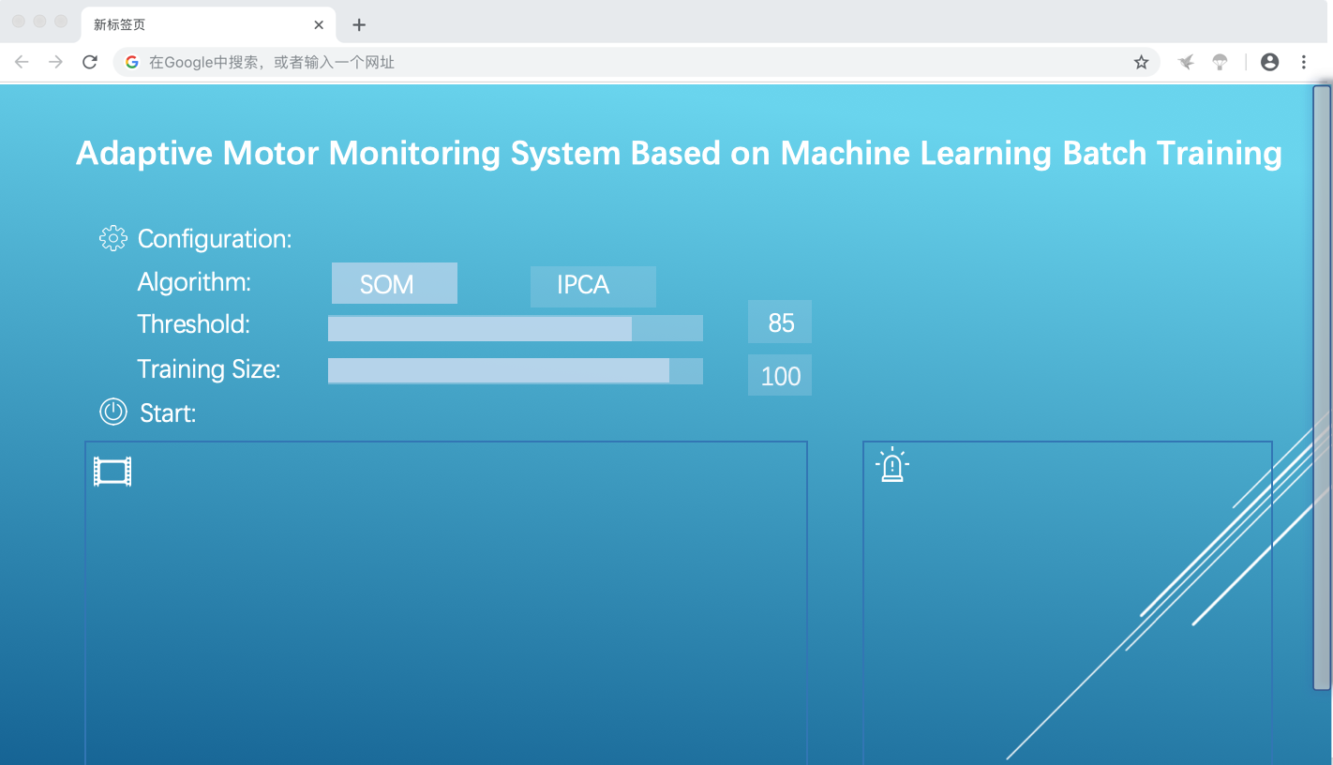
Web UI
Basic interaction
Web UI Design

Slide 5
Web UI
Basic interaction
Web UI Design

Slide 6
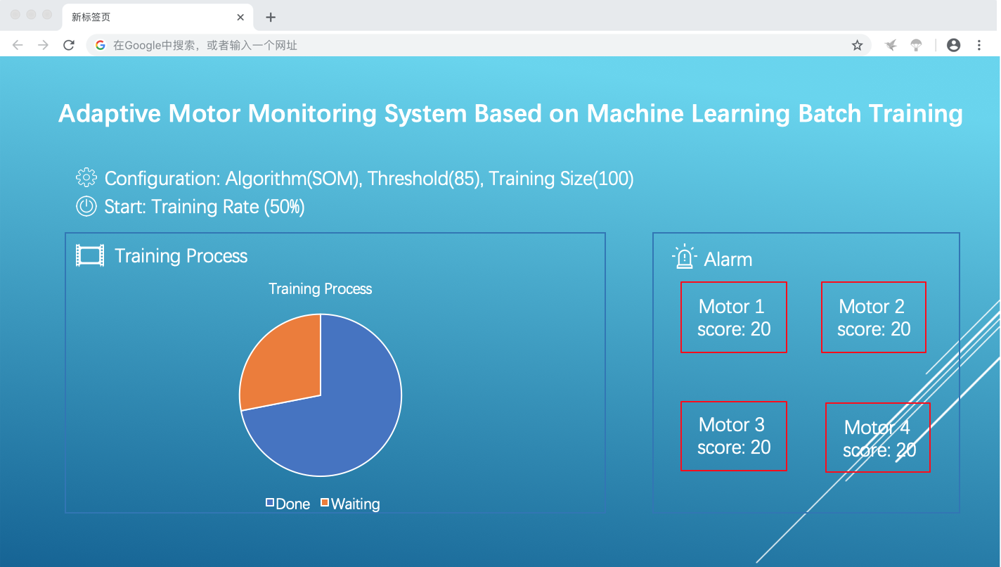
Web UI
Basic interaction
Web UI Design

Slide 7
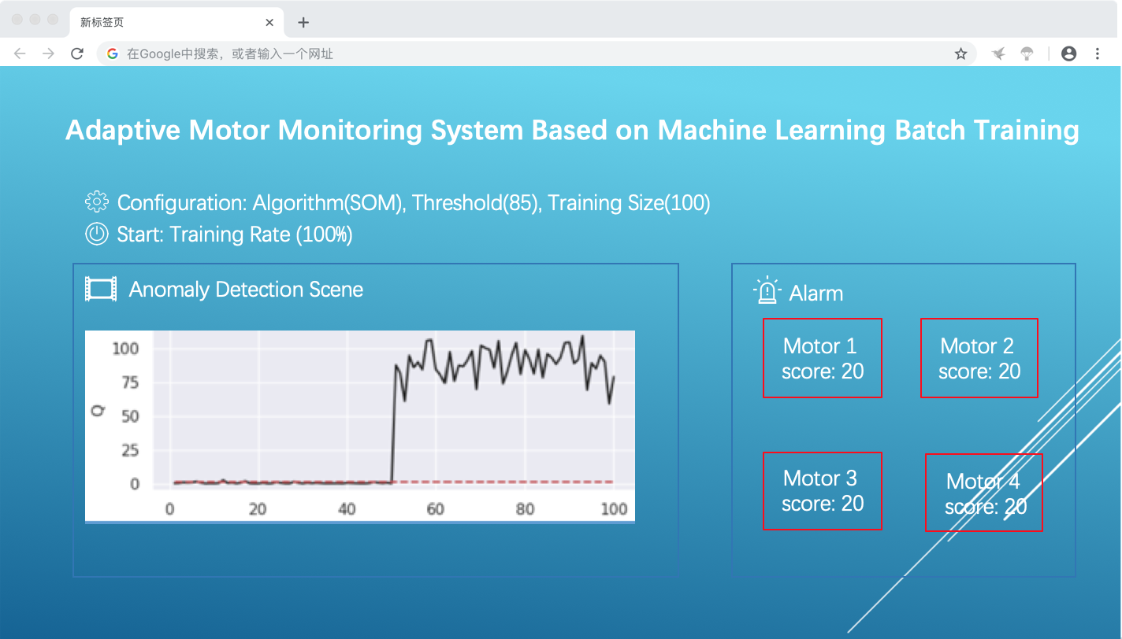
Web UI
Basic interaction
Web UI Design

Slide 8
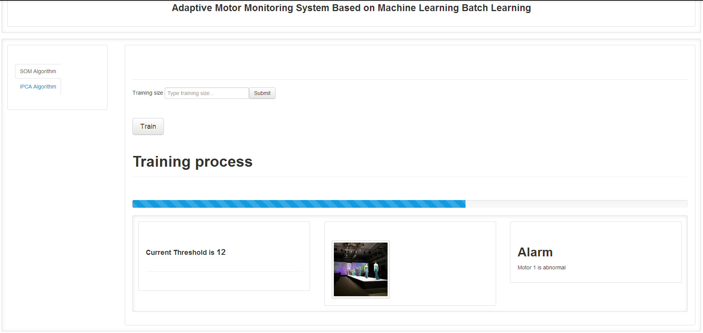
Current Web UI

Slide 9

IPCA+Q (Incremental PCA with Q statistic)
Comparison between IPCA and PCA
IPCA has the advantage that it can train in specific batch_size
Q-statistic comparison:

Slide 10
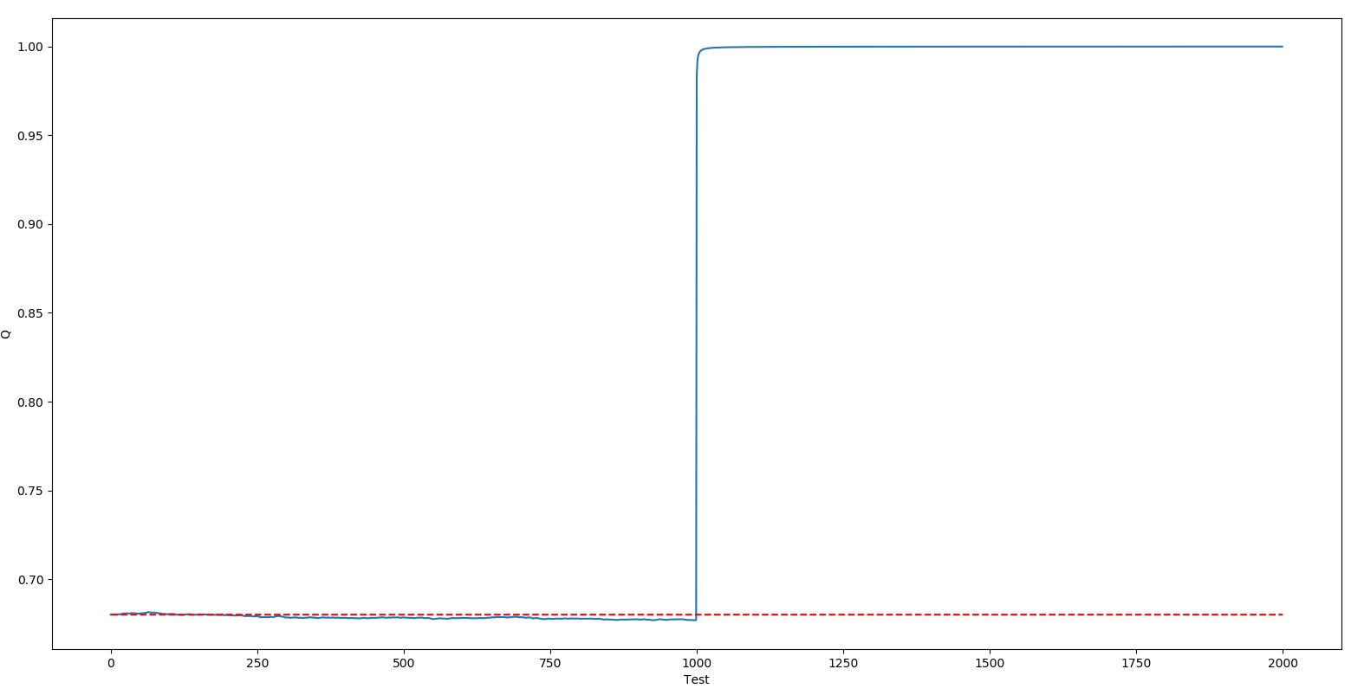
IPCA+Q (Incremental PCA with Q statistic)

Slide 11
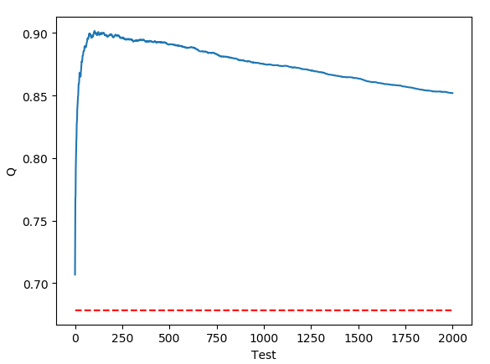
IPCA+Q (Incremental PCA with Q statistic)
当所有数据扩大十倍

Slide 12
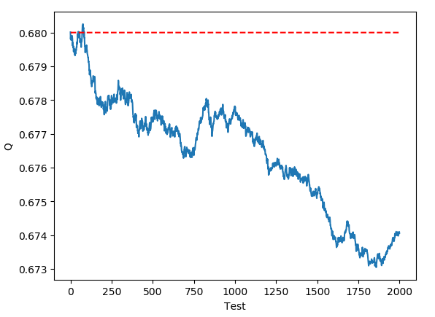
IPCA+Q (Incremental PCA with Q statistic)
当所有数据正常

Slide 13
Batch Training Algorithm Comparison
SOM-MQE vs IPCA-Q
训练时间与准确度相似
SOM-MQE statistic is more reliable
IPCA-Q：
IPCA只有partial_fit一种训练方法，在训练完毕后需要将最后IPCA模型的Q-statistic 保存下来作为threshold
接下来也同样用partial_fit 方法测试数据集，Q的值会大于threshold如果数据异常
缺陷：Q的上限为1，可能会导致某些细微的波动难以察觉

